Slide 1

E-CERTIFICATES ISSUE SERVICES USING BLOCKCHAIN
Date: 08 April 2021
MANDALA SUSMITHA : 17WH1A0591
AREPALLI SINDHURA : 17WH1A05A6
V KRISHNA GAYATRI : 18WH5A0521
Internal Guide: Prof. R S MURALI NATH
Designation: Professor I/C Accreditations
Department of Computer Science & Engineering
BVRIT HYDERABAD College of Engineering for Women

Slide 2
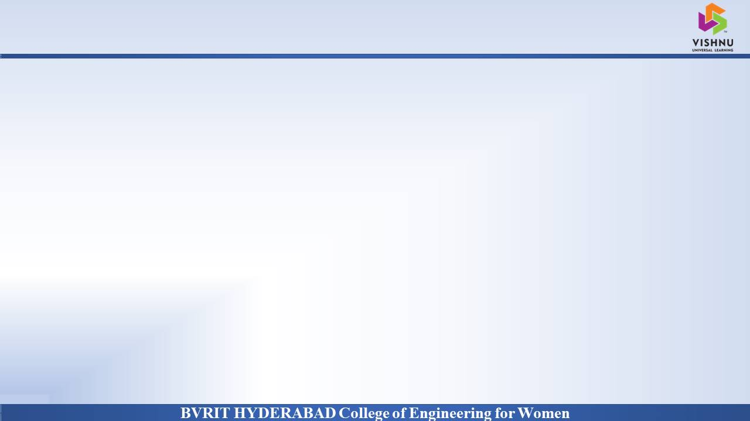
Abstract
Why Should I Study this course?
Examples
Students often have to go to their colleges in order to collect their certificates. There might be many of them who might be working or studying at different places and may not be able to come to college to collect the documents needed. This project aims to reduce this difficulty by providing a website to students wherein they can request for the documents they need. The user will be authorized based on their college email id and password. They can then go to the home page and click on the certificate they need.
The student can request to get any of the following certificates : Academic certificates such as marks memo, certificates provided after graduation – CMM(Consolidated Marks Memo), OD(Original Degree), TC(Transfer certificate) and recommendation letters for higher studies. These requests to get certificates is sent to examination branch and/or concerned authorities who will upload the scanned copies. The students can download these certificates. The application also gives a provision for 3rd party verification where a company can request to know the details of a particular student. They can send a sample file for example format.
BVRIT HYDERABAD College of Engineering for Women

Slide 3
System Requirements
Why Should I Study this course?
Examples
Environment | Specifications
Hardware | 2GB Storage space
 | 4GB RAM
 | Intel I5 Core Processor
Software | Sublime text (text editor),eclipse
 | Mysql / blockchain
BVRIT HYDERABAD College of Engineering for Women

Slide 4
Timeline
Why Should I Study this course?
Review | Excepted Completion
Review 0 | Requirements Specification Details of Features Base paper and references
Review 1 | Detailed designs Front end pages Mysql tables creation Integration of frontend and backend
Review 2 | Complete Implementation Further enhancements Report for the Project
Examples
BVRIT HYDERABAD College of Engineering for Women

Slide 5
References
Why Should I Study this course?
Chenfu Xu, Hui Yang, Qinyong Yu, Zesong Li – A trusted and Flexible Electronic Certificate Catalog Sharing System Based on Consortium Blockchain in 2019 (Base paper)
Neethu Gopal, Vani V Prakash – Survey on Blockchain Based Digital Certificate System in 2018
Anjaneyulu Endurthi, Akhil Khare - Certificate Management System Using Blockchain in 2020
Nitin Kumavat, Swapnil Mengade, Dishant Desai, Jesal Varolia - Certificate Verification System using Blockchain in 2019
Examples
BVRIT HYDERABAD College of Engineering for Women

Slide 6
Thankyou
BVRIT HYDERABAD College of Engineering for Women

